Slide 1
LAB 1 Presentation
Jorge Cubillo 11-05-202
SM6106 - Systems Analysis

Slide 2
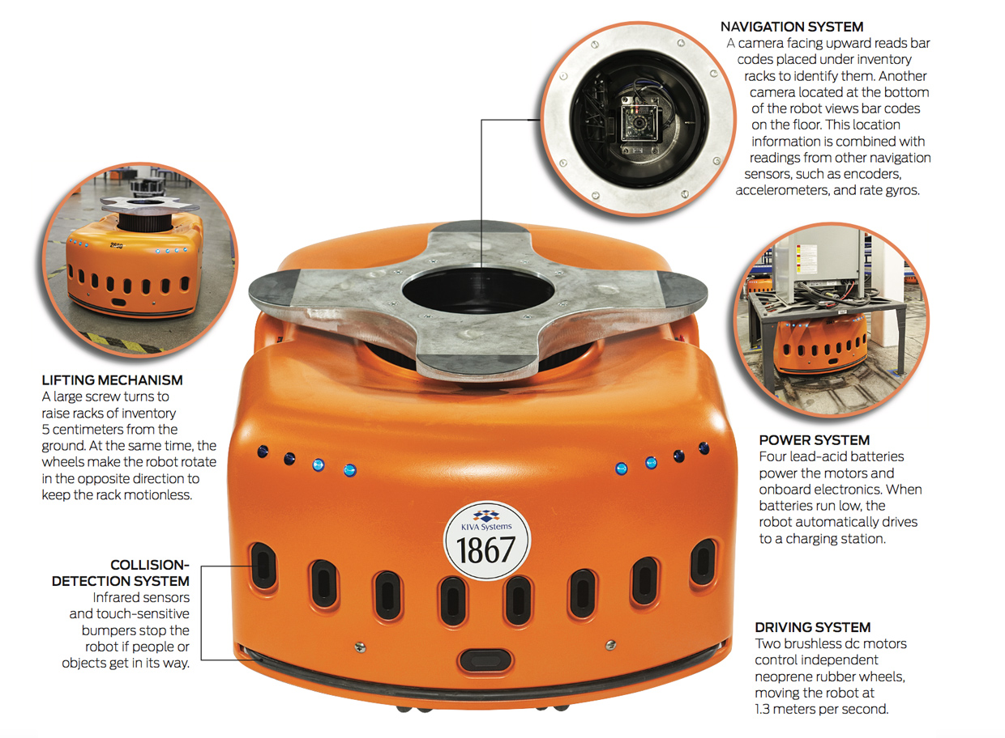
The Kiva is a game changing automation technology distribution environment. Kiva system primarily responsibility is to act as a forward pick & pack zone with the overall of distribution center process and operation that are managed by the Warehouse Management system (WMS)
• Receiving
• Replenishment
• Slotting / Location Management
• Picking
• Packing
• Quality Control
• Shipping
• Labor Management

Slide 3
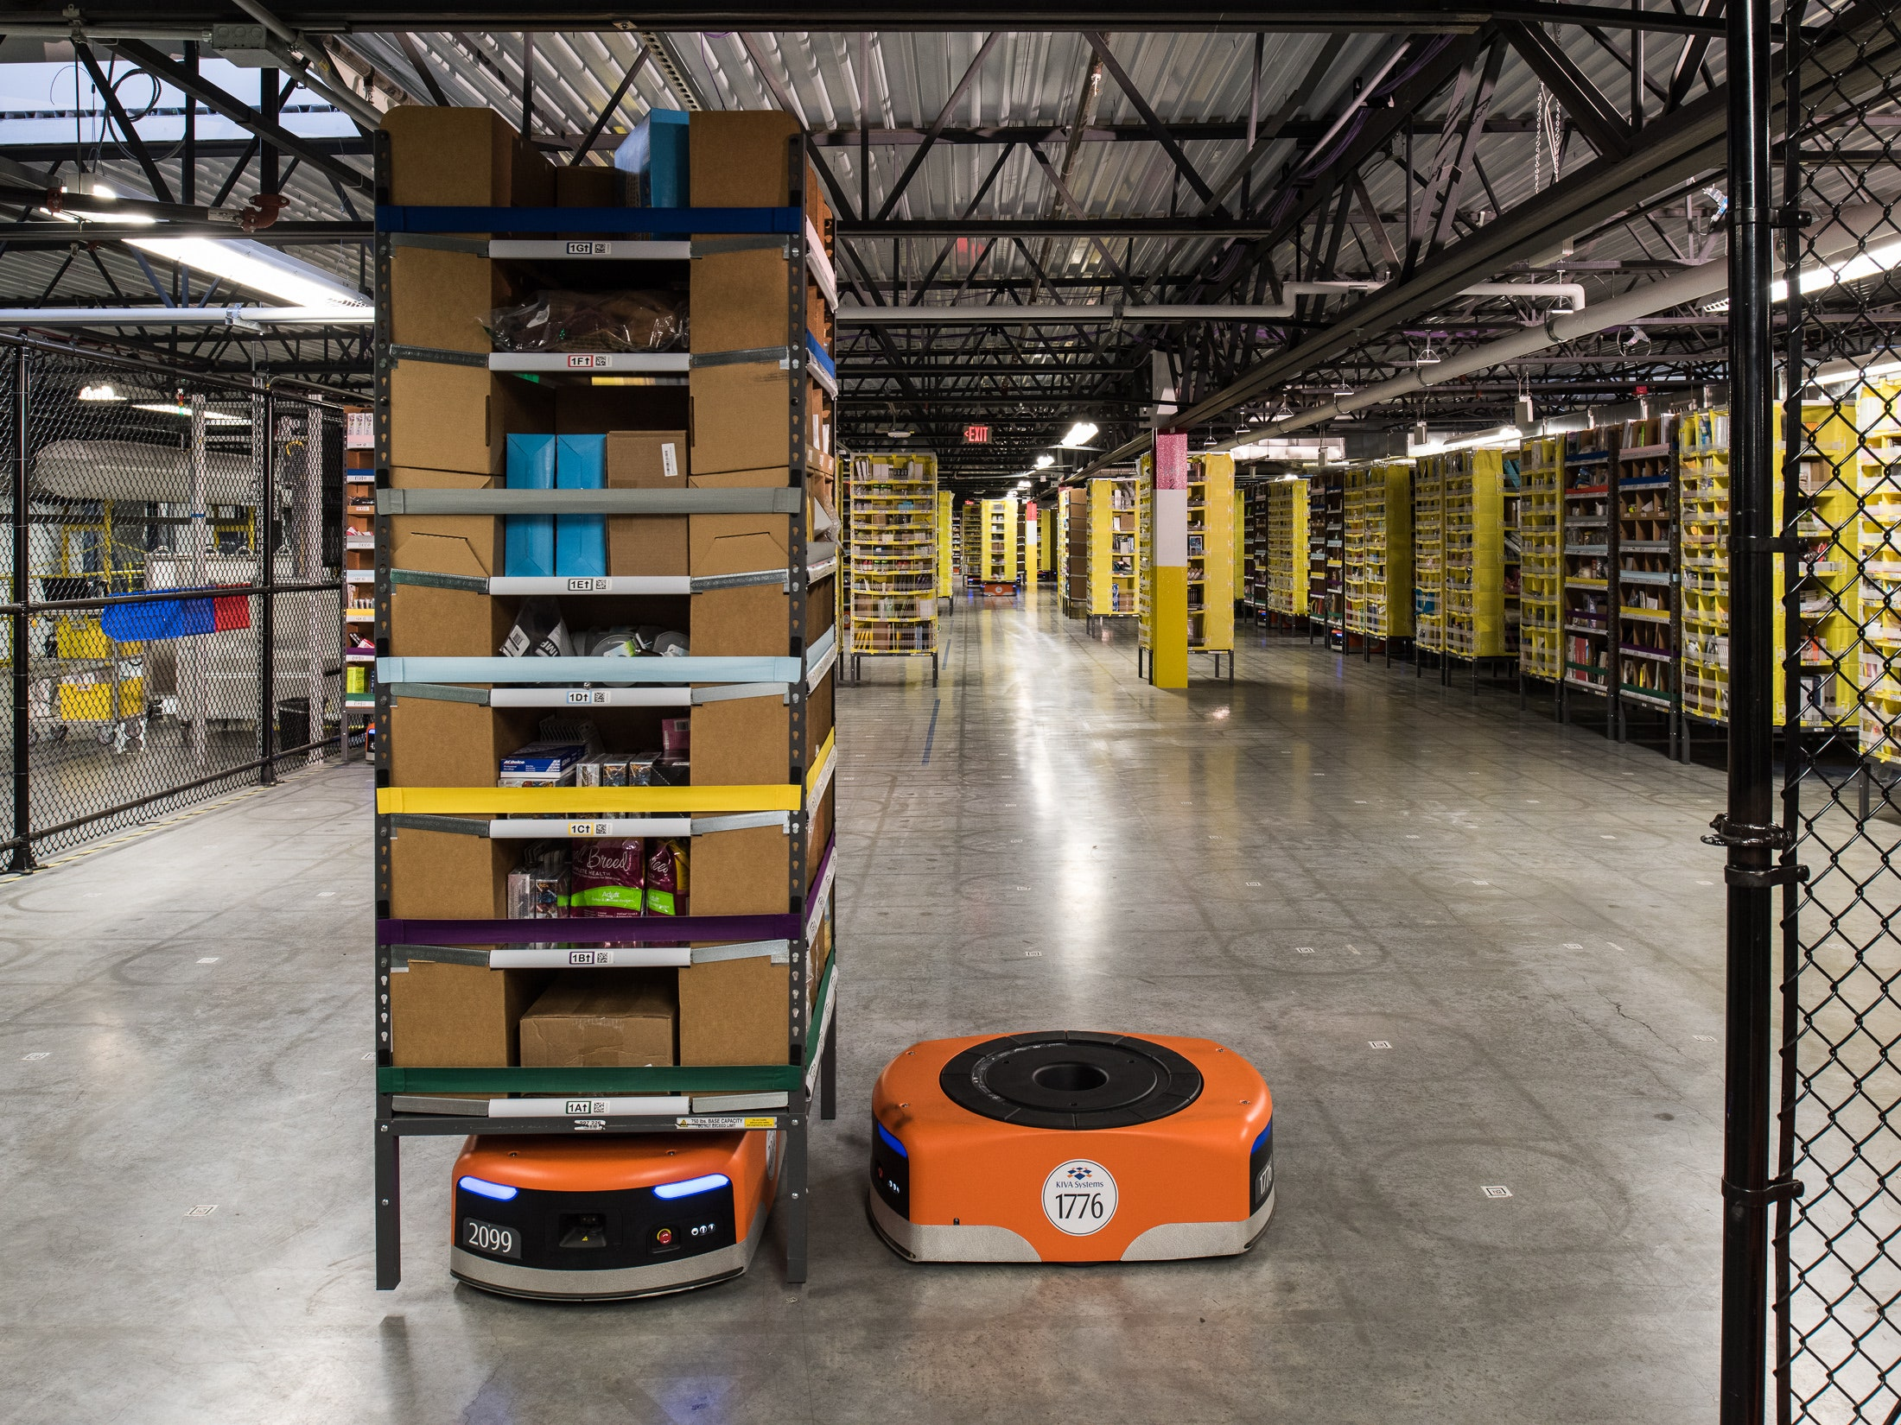
How it Work
Identify Target Pod
Fetching
Tunneling
Lifting the Pod
Street Driving
Highway Driving
Crossing Over
Queuing
Returning to Storage
Finding a new spot
leaving queue
crossing back
entering storage
Dropping the Pod
Charging

Slide 4
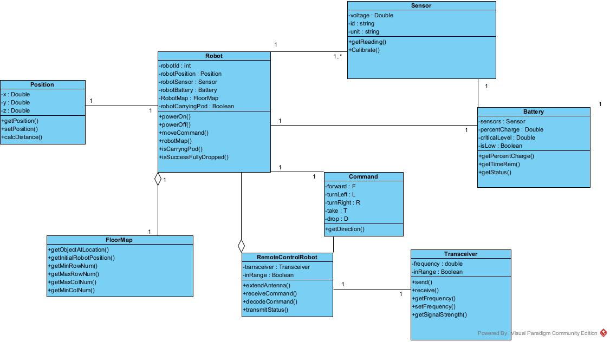
Robot’s UML Diagram

Slide 5
Reference Link
https://github.com/JorgeCubillo-FIU/Lab-1/tree/main/Kiva/src
https://www.youtube.com/watch?v=6KRjuuEVEZs
https://www.roboticstomorrow.com/article/2011/12/how-kiva-systems-and-warehouse-management-systems-interact/23/

Slide 6
THANK YOU
Group 4

